Slide 1

KIET Group of Institutions, Ghaziabad
IMPACT OF ETHNICITY ON PREVALANCE OF LUNG DISEASES
Group ID: PCSE25-09
Students Name: ALOK SINGH, DEVANSH VERMA, DHRUV GUPTA
Semester : 8
Department: Computer Science and Engineering
Name of Project Guide : Prof. YOGENDRA PAL
Date of Presentation : 26/05/2025
1

Slide 2
KIET Group of Institutions, Ghaziabad
Problem Statement
Respiratory diseases, including asthma, COPD, and lung cancer, remain among the leading causes of illness and death worldwide. While environmental and lifestyle factors like air pollution and smoking are well-established contributors, the role of ethnicity as a potential influencing factor has not been thoroughly quantified using modern data-driven approaches.
This project aims to explore whether ethnicity significantly impacts the prevalence of lung disorders, using a machine learning model that analyzes the relationship between ethnicity, air quality index (AQI), and regional smoking rates. By training and testing the model on a synthesized dataset representing diverse ethnic backgrounds, the study reveals that ethnicity does play a substantial role in determining lung disease risk when combined with environmental and behavioral factors.
2

Slide 3
KIET Group of Institutions, Ghaziabad
Solution
1. Predictive Web-Based Tool
Developed using Naive Bayes model integrated with a web interface.
Inputs: Ethnicity, AQI, Smoking %.
Output: Lung disease risk level (Low/Medium/High) with probability score.
2. Public Health Insights
Highlights high-risk ethnic groups based on environmental exposure.
Enables targeted health interventions in specific communities.
3. Policy-Level Impact - Supports decision-making for:
Air quality regulations
Community-specific awareness campaigns
Smoking control initiatives
4. Accessible Technology
Built using HTML, CSS, JS, Python, Flask.
Lightweight and scalable—suitable for under-resourced areas.
3

Slide 4

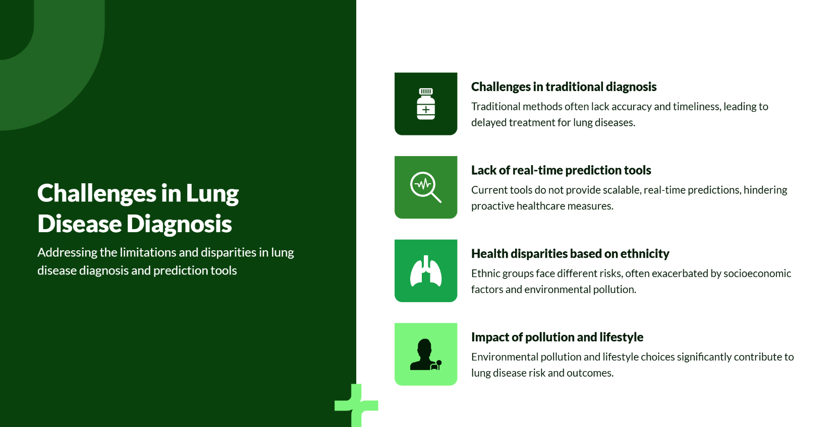

Slide 5
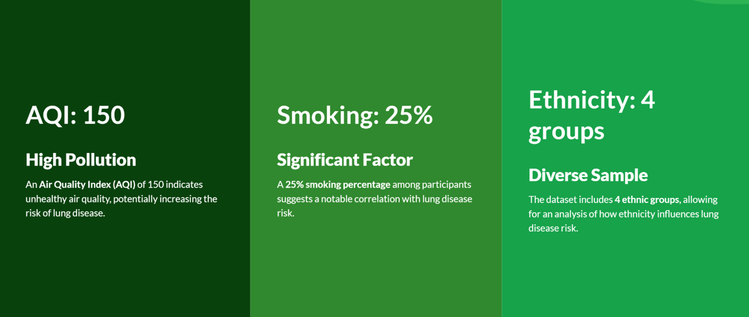
Lung Disease Risk Dataset Overview

Slide 6
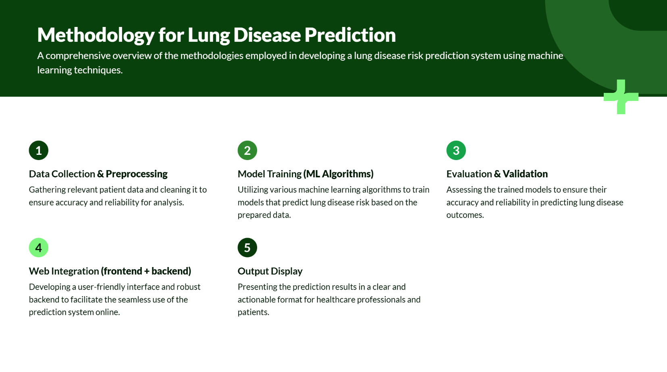

Slide 7
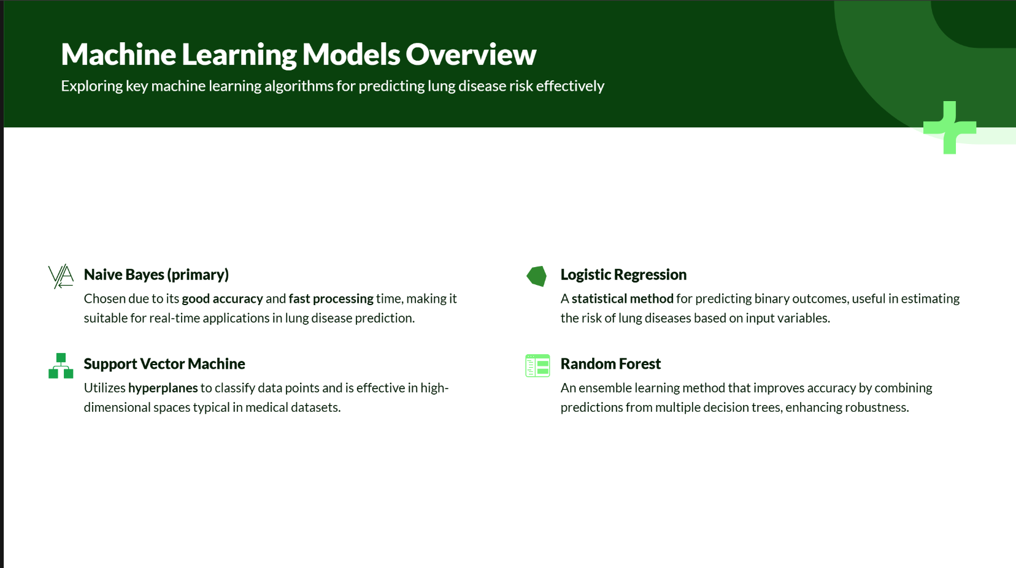

Slide 8
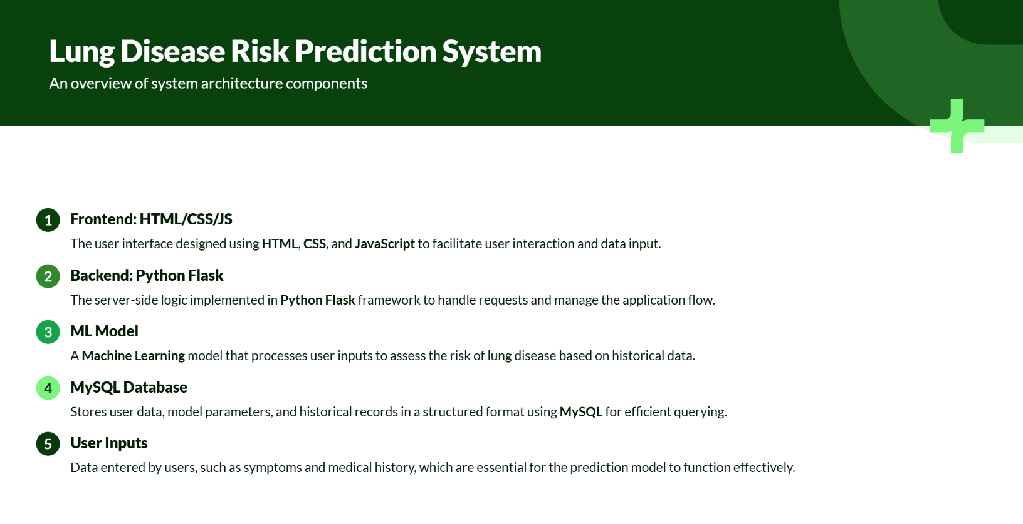

Slide 9
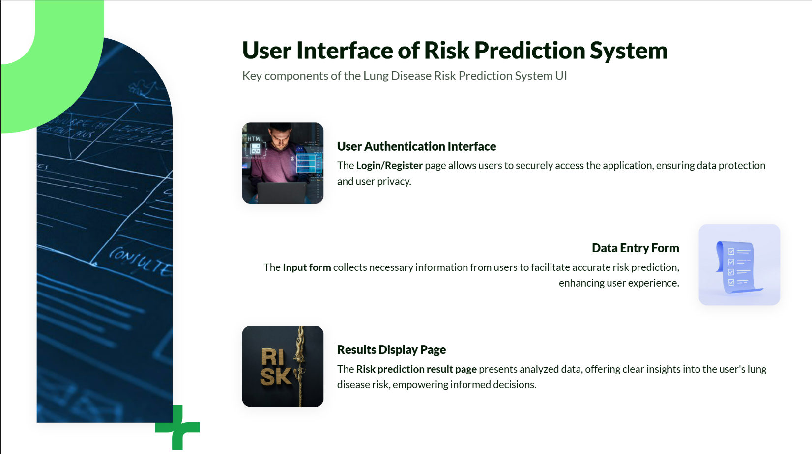

Slide 10
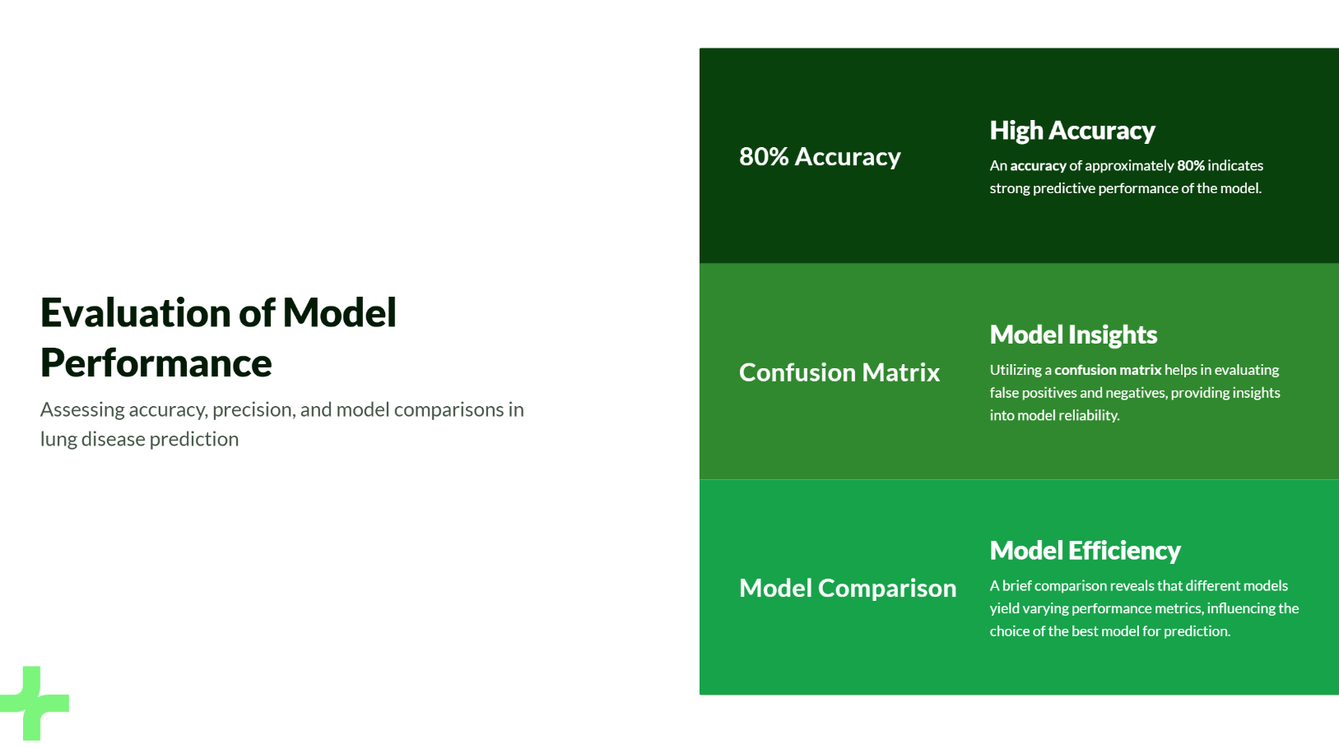

Slide 11
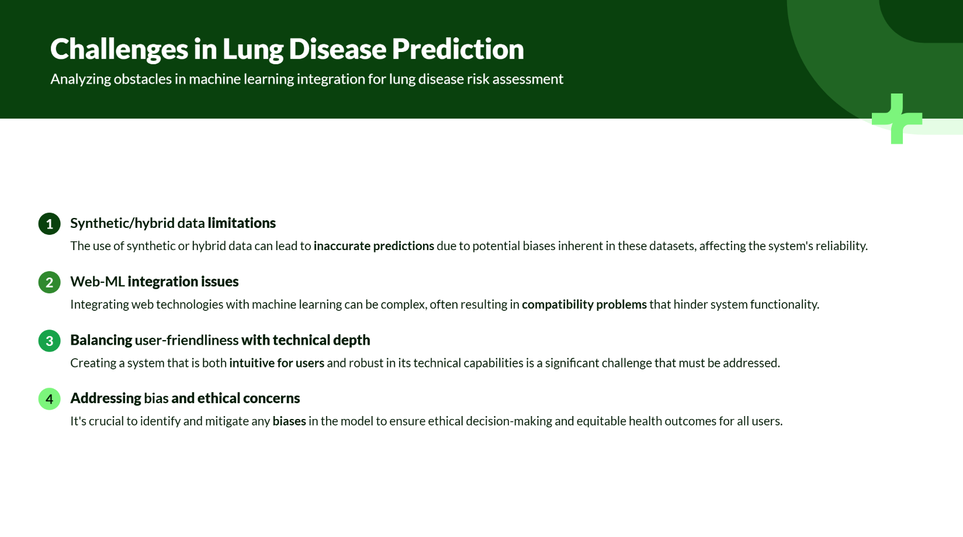

Slide 12
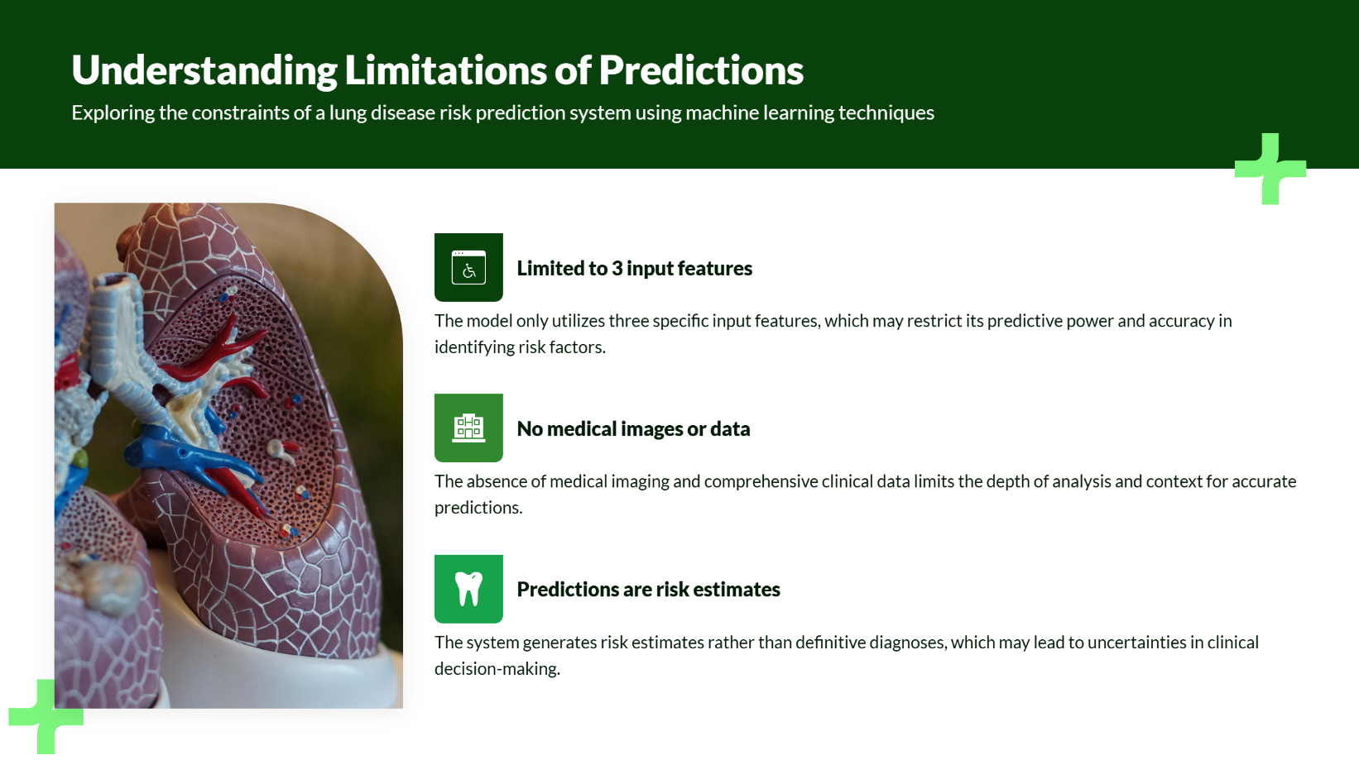

Slide 13
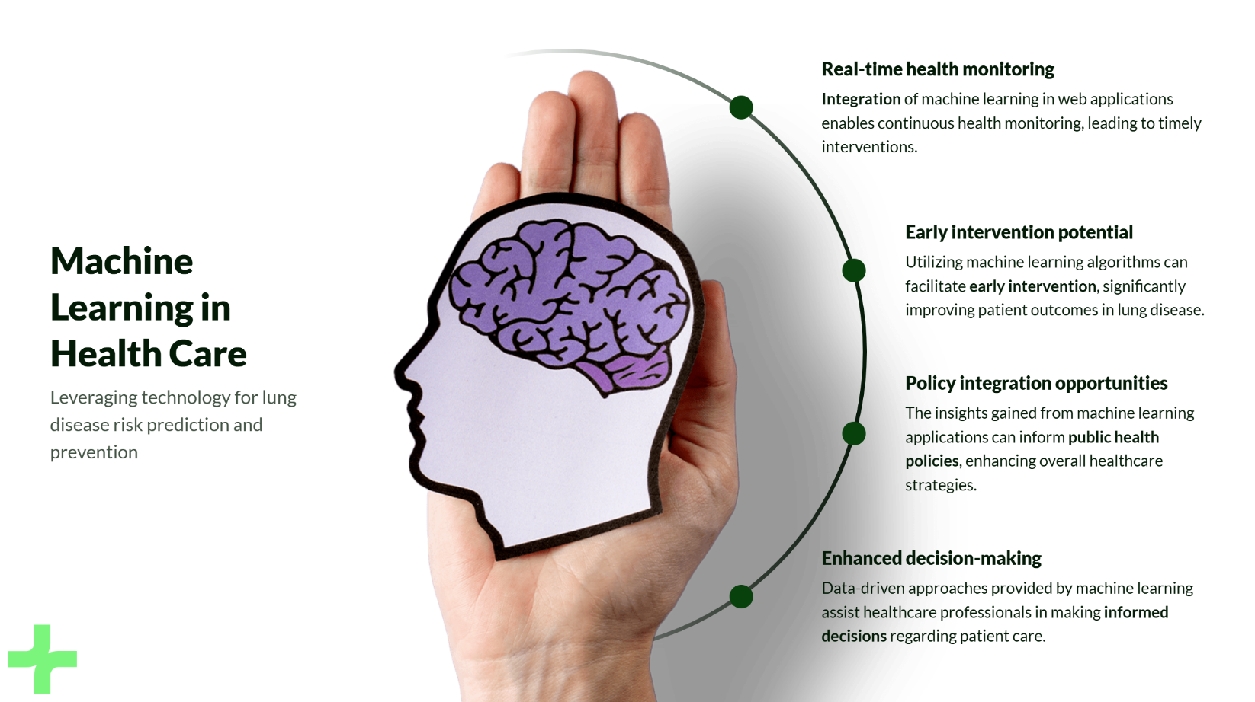

Slide 14
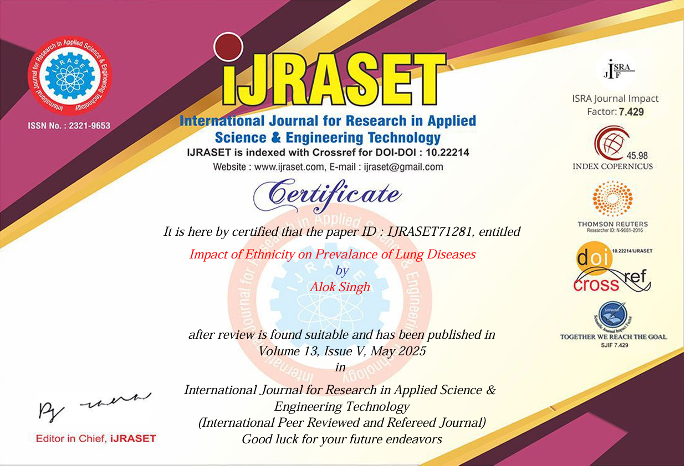

Slide 15


Slide 16
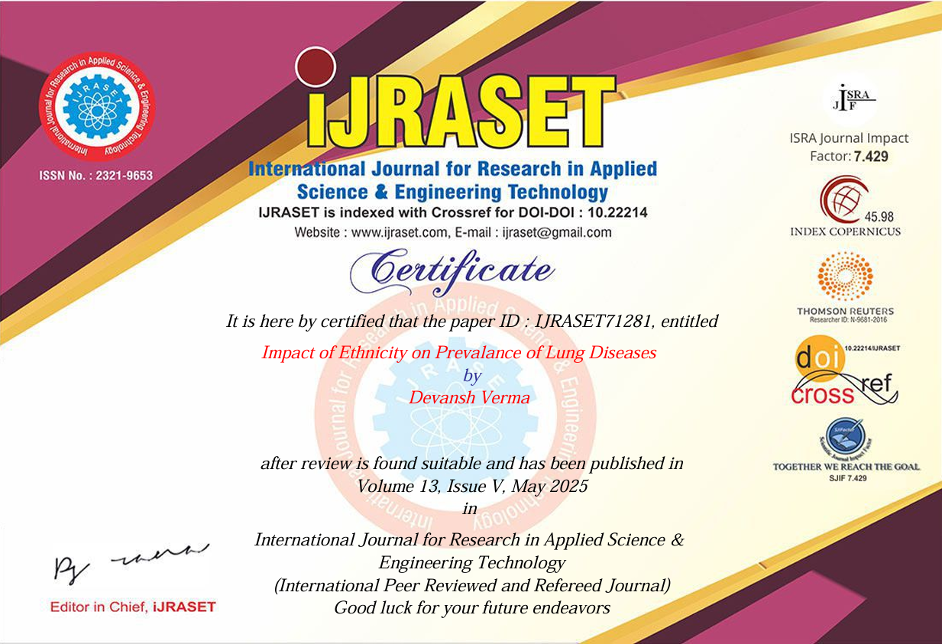

Slide 17


Slide 18


